Slide 1
Ruby on Rails for Beginners

Slide 2

Faculty
 | Mahima Agarwal Saran
 | Team Lead
 | ADOP Offshore Lead
 | DCSC, Mumbai IDC

Slide 3
Agenda
What is Ruby on Rails (RoR)?
Why Ruby?
Rails Strengths and Features
Rails Architecture
Processing URLs
Installing Rails on Windows
Creating a basic site
Directory Structure
Rails Environment Modes
Starting Rails Server

Slide 4

What is Ruby on Rails (RoR)?
An extremely productive web-application framework.
Written in Ruby
An open source Ruby framework for developing database-backed web applications
You could develop a web application at least ten times faster with Rails than you could with a typical Java framework
Configure your code with Database Schema
No compilation phase required

Slide 5
Agenda
What is Ruby on Rails (RoR)?
Why Ruby?
Rails Strengths and Features
Rails Architecture
Processing URLs
Installing Rails on Windows
Creating a basic site
Directory Structure
Rails Environment Modes
Starting Rails Server

Slide 6
Why Ruby?
A high-level programming language
Interpreted like Perl, Python, Tcl/TK ((No compile step necessary)
Object-oriented like Smalltalk, Eiffel, Ada, Java
Easy to learn and Open source
Rich libraries
Very easy to extend
Truly object-oriented
Less coding with fewer bugs
Helpful community

Slide 7
Agenda
What is Ruby on Rails (RoR)?
Why Ruby?
Rails Strengths and Features
Rails Architecture
Processing URLs
Installing Rails on Windows
Creating a basic site
Directory Structure
Rails Environment Modes
Starting Rails Server

Slide 8
Rails Strengths and Features
Full Stack Framework
Convention over Configuration
Metaprogramming
Includes everything needed to create a database-driven web application
Use the Model-View-Controller pattern
Notion that coding is reduced if we adopt a standard way of doing things
Code look for each other by their common names
Uses Metaprogramming techniques to write programs
Its an act of writing code that operates on code rather than on data
Eg., if we have a class "Pet" in our model that defines the characteristic of domestic animal, in rails, the database table created for us will be named "pets"

Slide 9
Rails Strengths and Features
Active Record
Scaffolding
Built-in testing
Rails introduces the Active Record framework
Saves objects into the database
Temporary way to get applications wired quickly
Allows to generate all the basic CRUD operations for simple models
Rails creates simple automated tests
These tests can be extended
Rail execute all automated tests with the rake utility

Slide 10
Agenda
What is Ruby on Rails (RoR)?
Why Ruby?
Rails Strengths and Features
Rails Architecture
Processing URLs
Installing Rails on Windows
Creating a basic site
Directory Structure
Rails Environment Modes
Starting Rails Server

Slide 11
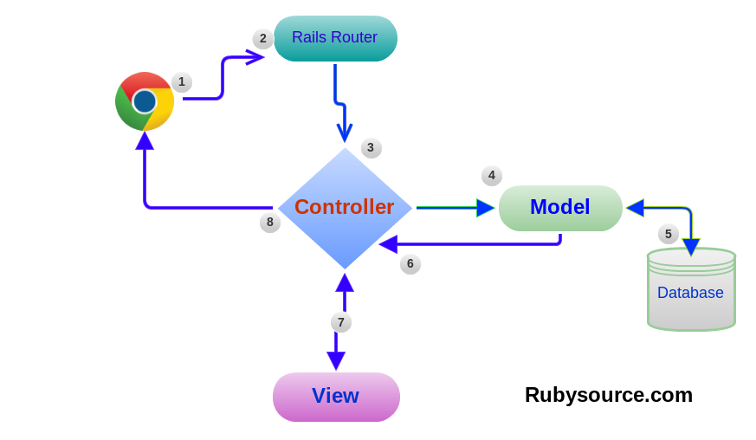
Rails Architecture
Rails applications are implemented using the Model-View-Controller (MVC)
Model - ActiveRecord
View - ActionView
Controller - ActionController

Slide 12
Agenda
What is Ruby on Rails (RoR)?
Why Ruby?
Rails Strengths and Features
Rails Architecture
Processing URLs
Installing Rails on Windows
Creating a basic site
Directory Structure
Rails Environment Modes
Starting Rails Server

Slide 13
Processing URLs
The basic url used to access a controller is of the form: http://server/controller/action
The controller will be one you generate, and the action will be one you've defined in your controller
So if you have a controller named "filer" and that controller has an action named "upload", the url will be something like http://127.0.0.1/filer/upload

Slide 14
Agenda
What is Ruby on Rails (RoR)?
Why Ruby?
Rails Strengths and Features
Rails Architecture
Processing URLs
Installing Rails on Windows
Creating a basic site
Directory Structure
Rails Environment Modes
Starting Rails Server

Slide 15
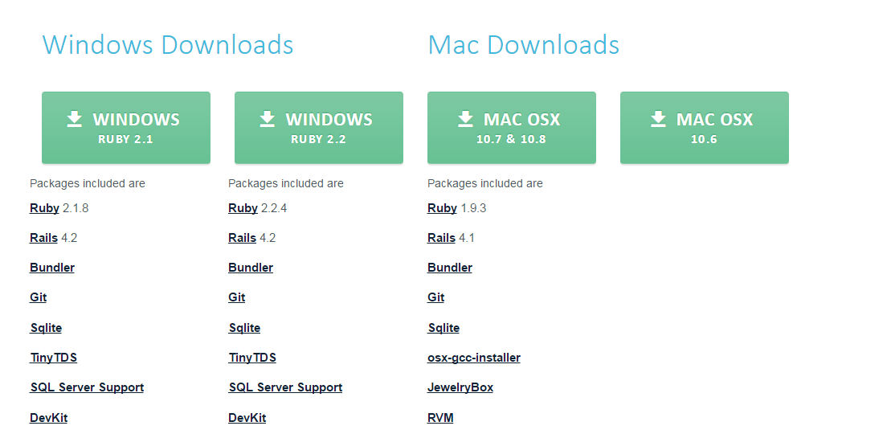
Installing Rails on Windows
Install Rails
Go to http://railsinstaller.org/en
Download the Windows Rails installer for Ruby 2.2 https://s3.amazonaws.com/railsinstaller/Windows/railsinstaller-3.2.0.exe

Slide 16
Agenda
What is Ruby on Rails (RoR)?
Why Ruby?
Rails Strengths and Features
Rails Architecture
Processing URLs
Installing Rails on Windows
Creating a basic site
Directory Structure
Rails Environment Modes
Starting Rails Server

Slide 17
Creating a basic site
$ mkdir workspace
$ cd workspace
$ rails new hello_app
create
create README.md
create Rakefile
create config.ru
create .gitignore
create Gemfile
create app
create app/assets/config/manifest.js
create app/assets/javascripts/application.js
create app/controllers/application_controller.rb
create vendor/assets/javascripts
create vendor/assets/stylesheets
create vendor/assets/stylesheets/.keep
remove config/initializers/cors.rb
run bundle install
Fetching gem metadata from https://rubygems.org/..........
Fetching additional metadata from https://rubygems.org/..
Resolving dependencies...
Installing rake 11.1.2
Using concurrent-ruby 1.0.2
Your bundle is complete!

Slide 18
Agenda
What is Ruby on Rails (RoR)?
Why Ruby?
Rails Strengths and Features
Rails Architecture
Processing URLs
Installing Rails on Windows
Creating a basic site
Directory Structure
Rails Environment Modes
Starting Rails Server

Slide 19
Directory Structure
app/ | Core application (app) code, including models, views, controllers, and helpers
app/assets | Applications assets such as cascading style sheets (CSS), JavaScript files, and images
bin/ | Binary executable files
config/ | Application configuration
db/ | Database files
doc/ | Documentation for the application
lib/ | Library modules
lib/assets | Library assets such as cascading style sheets (CSS), JavaScript files, and images
log/ | Application log files

Slide 20
Directory Structure
public/ | Data accessible to the public (e.g., via web browsers), such as error pages
bin/rails | A program for generating code, opening console sessions, or starting a local server
test/ | Application tests
tmp/ | Temporary files
vendor/ | Third-party code such as plugins and gems
vendor/assets | Third-party assets such as cascading style sheets (CSS), JavaScript files, and images
README.md | A brief description of the application
Rakefile | Utility tasks available via the rake command
Gemfile | Gem requirements for this app

Slide 21
Agenda
What is Ruby on Rails (RoR)?
Why Ruby?
Rails Strengths and Features
Rails Architecture
Processing URLs
Installing Rails on Windows
Creating a basic site
Directory Structure
Rails Environment Modes
Starting Rails Server

Slide 22
Rails Environment Modes
Rails runs in different modes, depending on the parameters given to the server on startup. Each mode defaults to it’s own database schema
Development (verbose logging and error messages)
Test
Production

Slide 23
Agenda
What is Ruby on Rails (RoR)?
Why Ruby?
Rails Strengths and Features
Rails Architecture
Processing URLs
Installing Rails on Windows
Creating a basic site
Directory Structure
Rails Environment Modes
Starting Rails Server

Slide 24
Running the Rails server on a local machine
Adding a hello action to the Application controller.
Go to Application Directory
Start the server
Default environment is development
Default port is 3000
http://127.0.0.1:3000
$ cd ~/workspace/hello_app/
$ rails server Booting Puma Rails application starting on http://localhost:3000 => Run `rails server -h` for more startup options => Ctrl-C to shutdown server

Slide 25
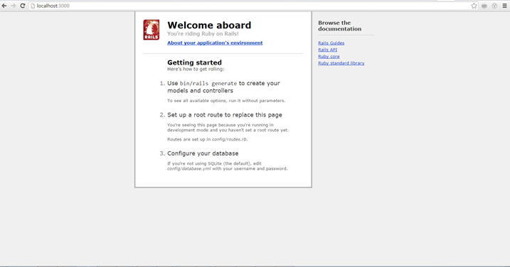
Running the Rails server on a local machine

Slide 26
Thanks for attending!

